Slide 1
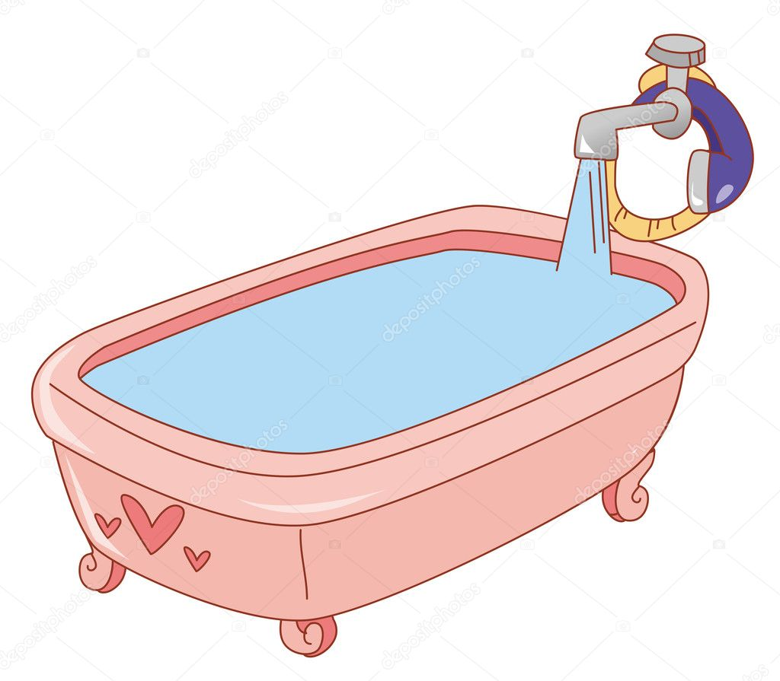

Slide 3
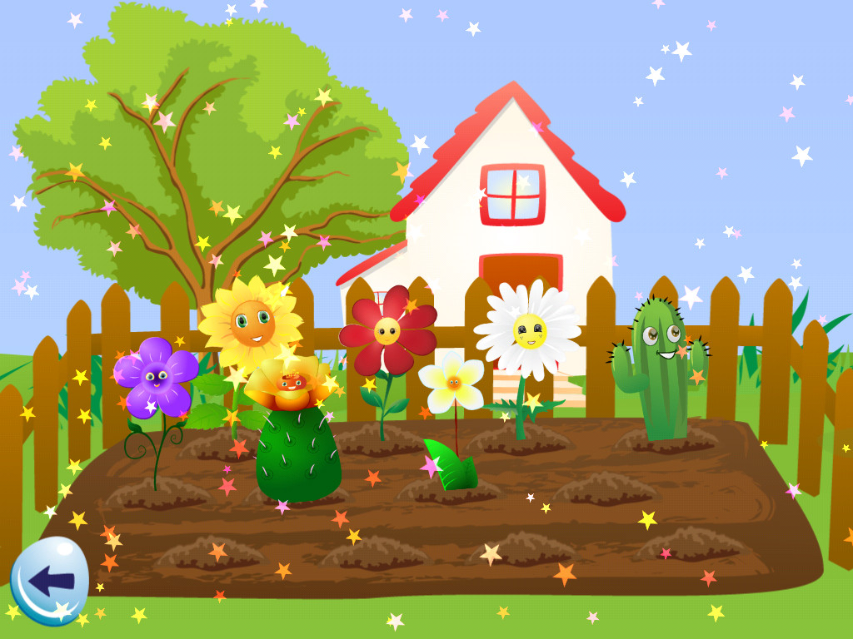

Slide 5
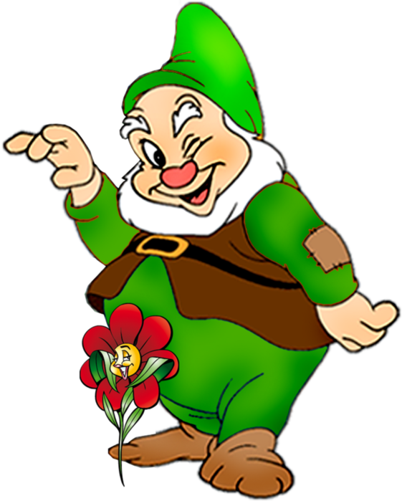
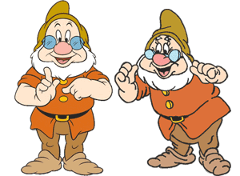
There are…
There is…

Slide 6
Выберите правильный ответ.
1. There is/ There are two boxes in the room.
2. There is/ There are a glass in the kitchen.
3. There is/ There are a sofa in the bedroom.
4. There is/ There are some carrots on the table.

Slide 8
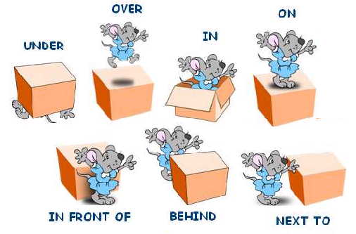
Предлоги места

Slide 9
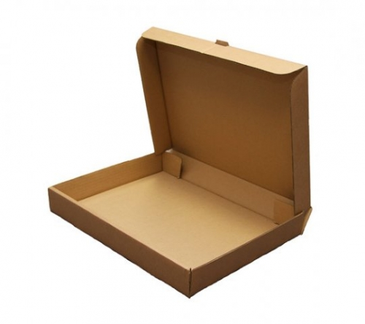
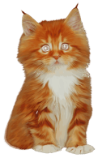
VS

